Slide 1

Open Source BIM (.org)
Léon van Berlo

Slide 2
Open Source BIM
Open Source BIM collective
Collective of individual open source projects
Collaborate on ‘boring’ stuff (hosting, marketing, legal questions,…)
Committed to interconnect individual tools to a seamless experience
Holds ‘main’ projects, but also plugins, micro standards (for the interconnection) and experimental research.

Slide 3
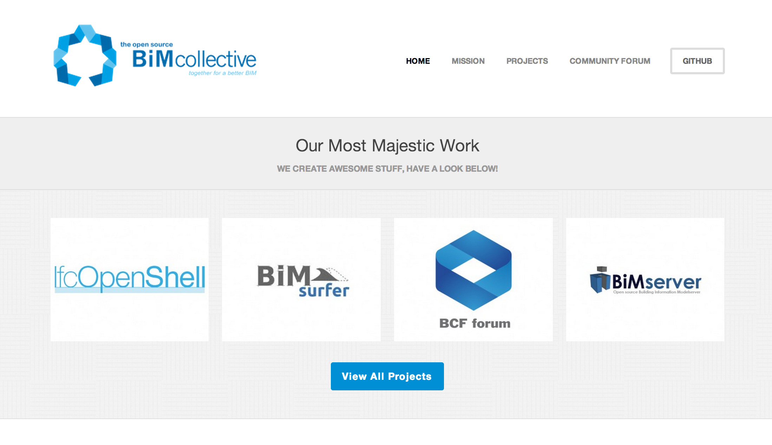
opensourcebim.org

Slide 4
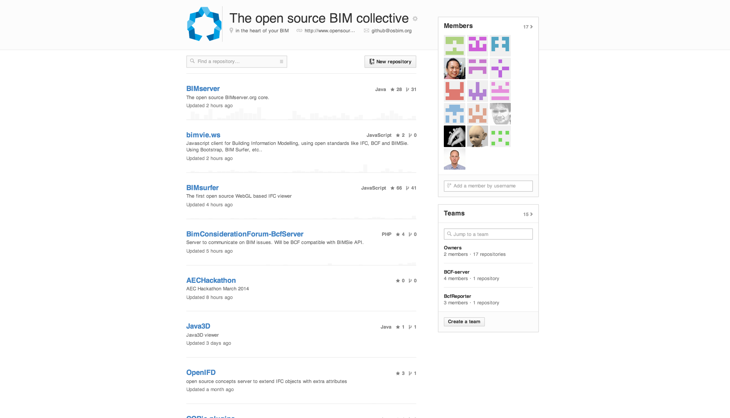

Slide 5
Where it all started: BIMserver.org
BIMserver.org mission is to help all actors in the Architectural, Engineering and Construction (AEC) industry to collaborate more efficiently and effectively (and thereby creating better buildings for lower costs).
BIMserver.org goal is to create the most favourite software platform for collaboration in the AEC-industry.
www.bimserver.org - wiki.bimserver.org

Slide 6
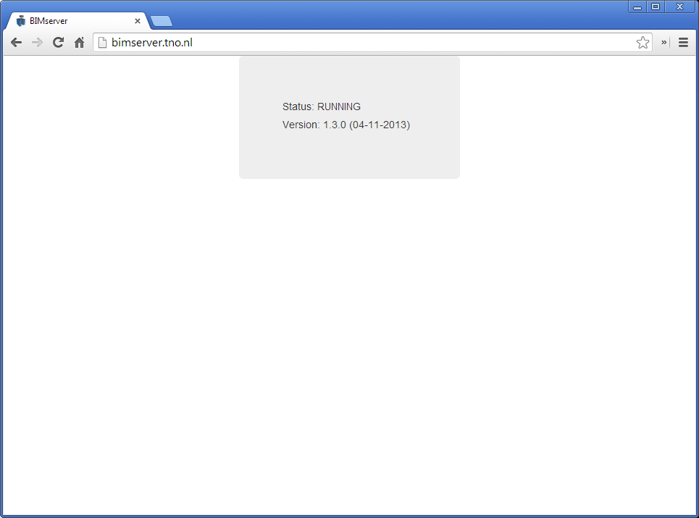
How it looks….

Slide 7
BIMserver tactics:
Mission: help AEC to collaborate more efficiently and effectively
+
Position: researchers = not software vendors
Creating a platform for others to build on top / extend;
No direct end-users;
Creating a snowball effect;
=
Goal: create most favourite platform by lowering the threshold for developers of niche applications
=
Mission: help AEC to collaborate more efficiently and effectively

Slide 8
The plugin framework (example for ‘output’)
Remote Services
Internal services (‘apps’)
GUI plugins
Serializers
(import/export)
EMF
core
Object
IDMs
Database(s)
ServiceInterfaces
(SOAP, PB, JSON)
Including BIMSie standard
Merge
algorithms
Render engines
Query engines
Compare algorithms
Model-checkers

Slide 9
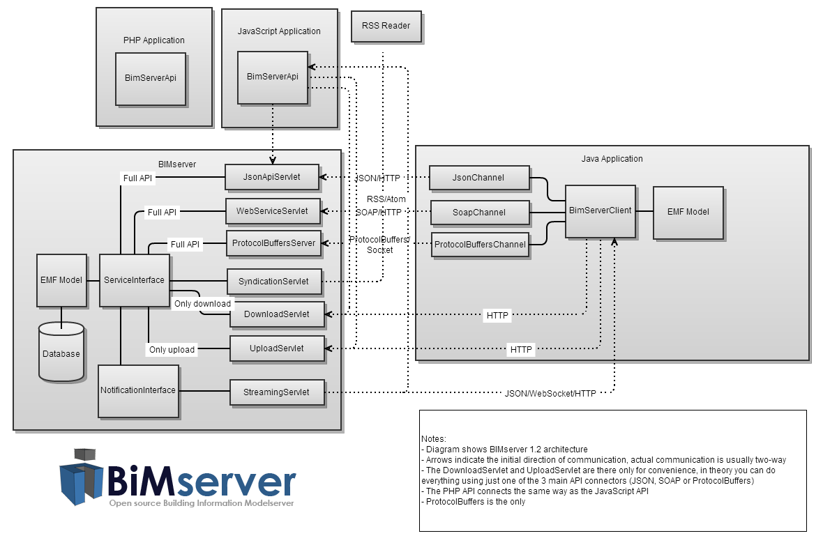

Slide 10
What BIMserver is….
Open and stable core to use and build on top
Core server features like revisions, authorization, compare, query, model checking, merging, etc..
Open interfaces, lots of network protocols (soap, PB, json)
Open standards
Plugin framework for render engines (like IfcOpenShell); ObjectIDMs & Query engines (like BimQL)
Flexible admin configuration & fine-tuning
Good developers documentation and SDK
Open source
Etc..

Slide 11
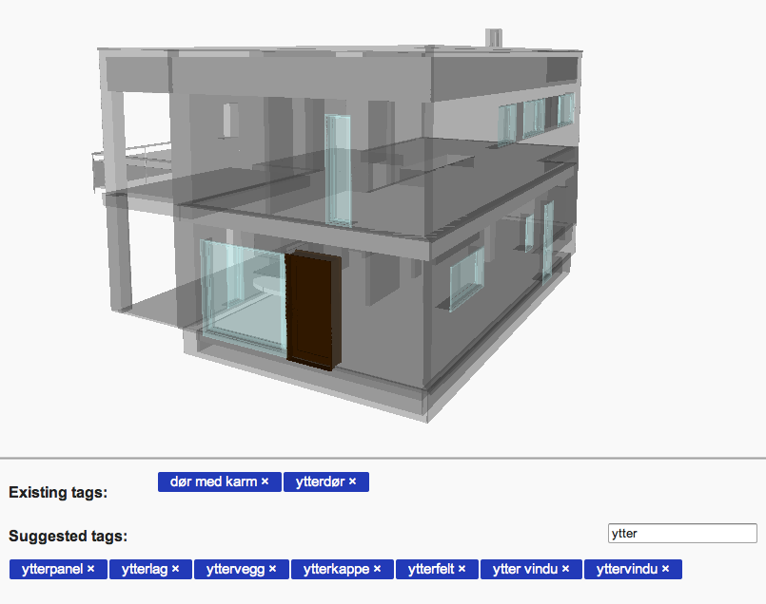
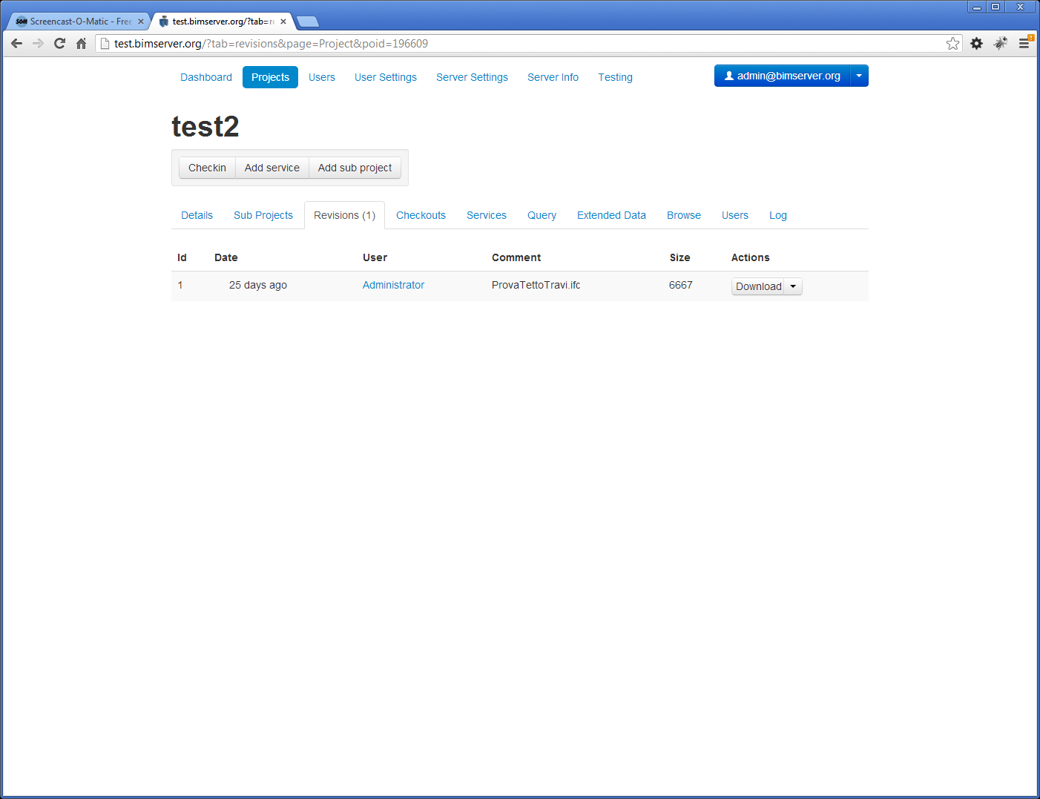
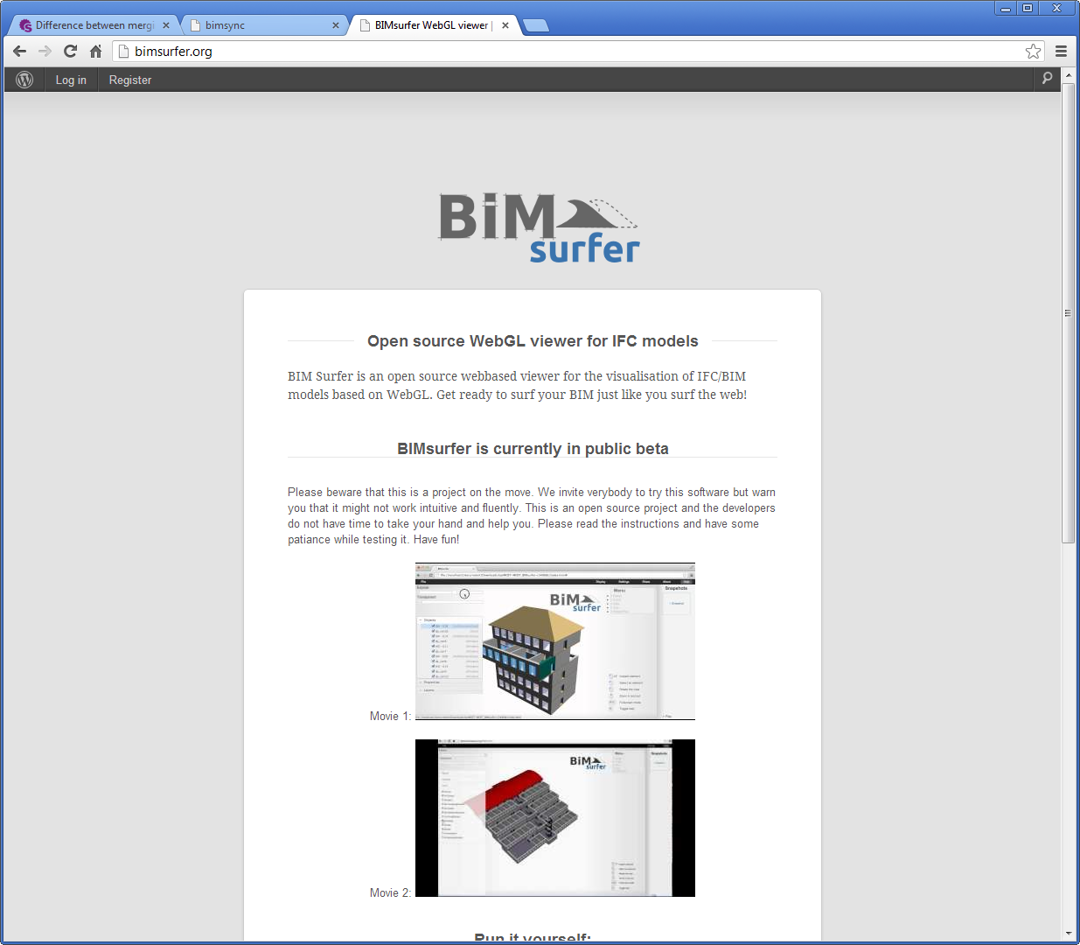
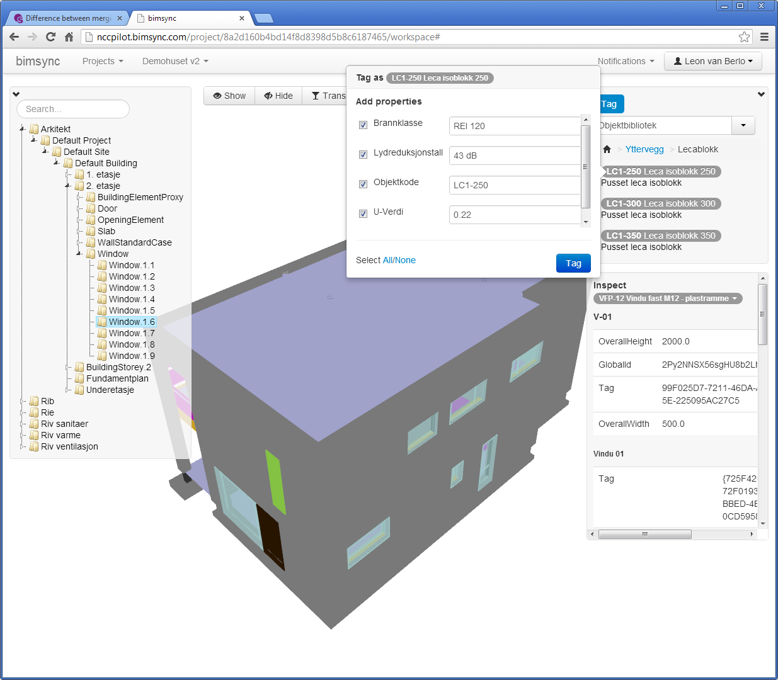
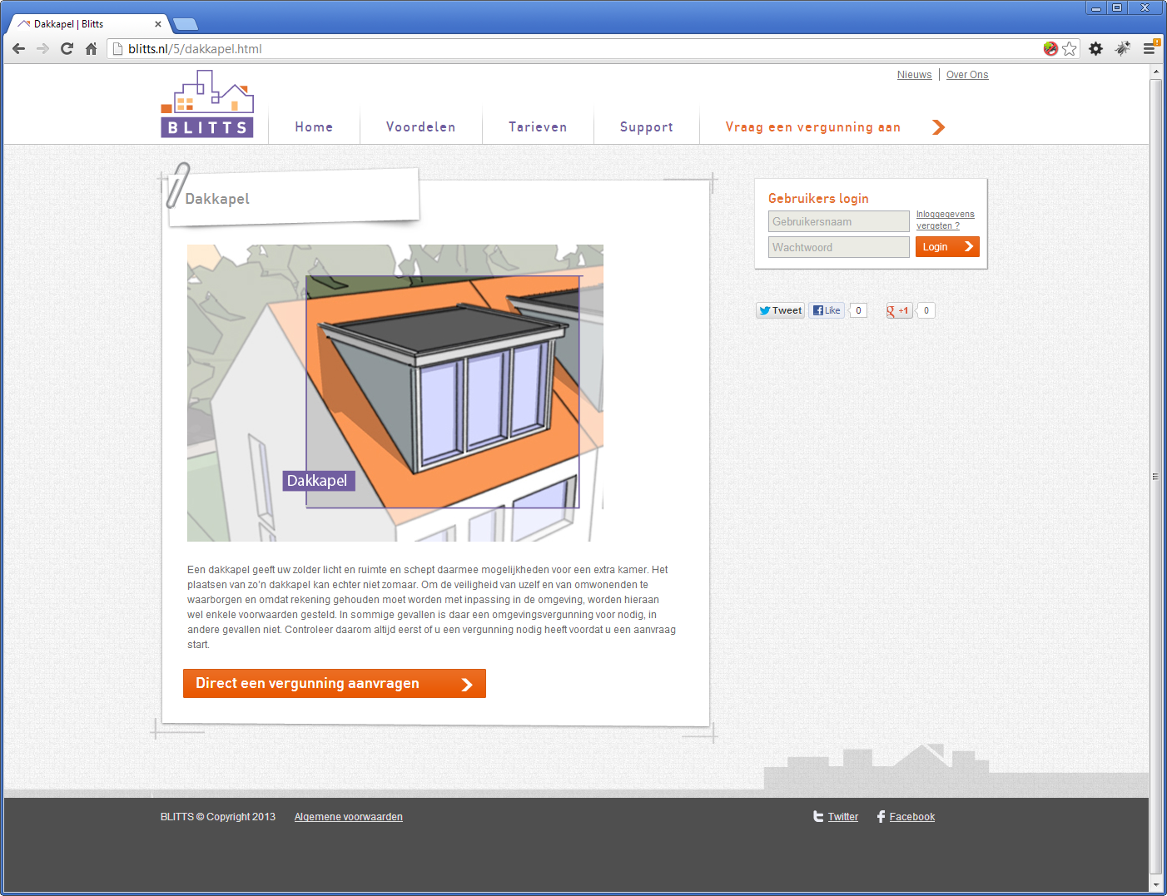
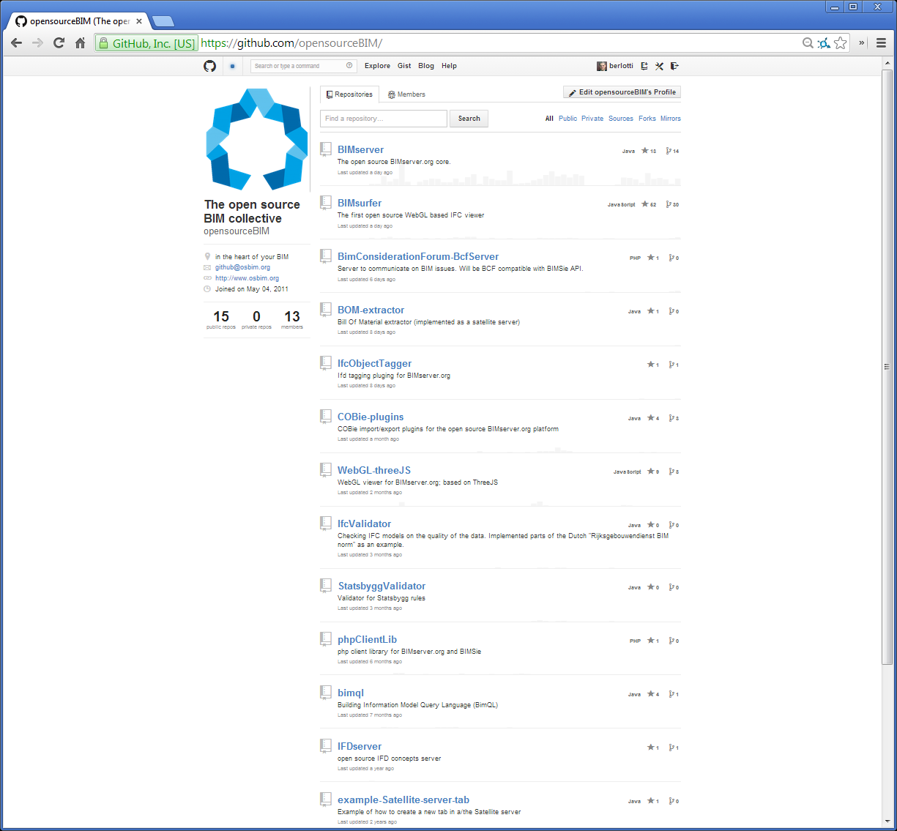
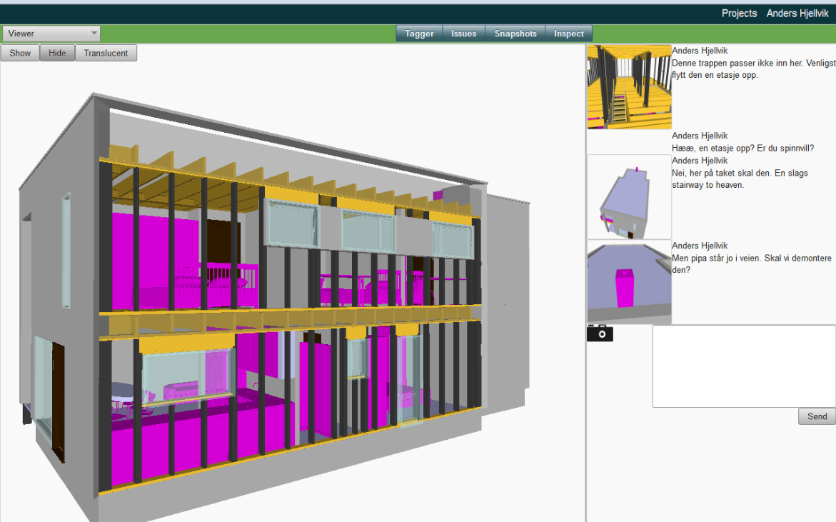
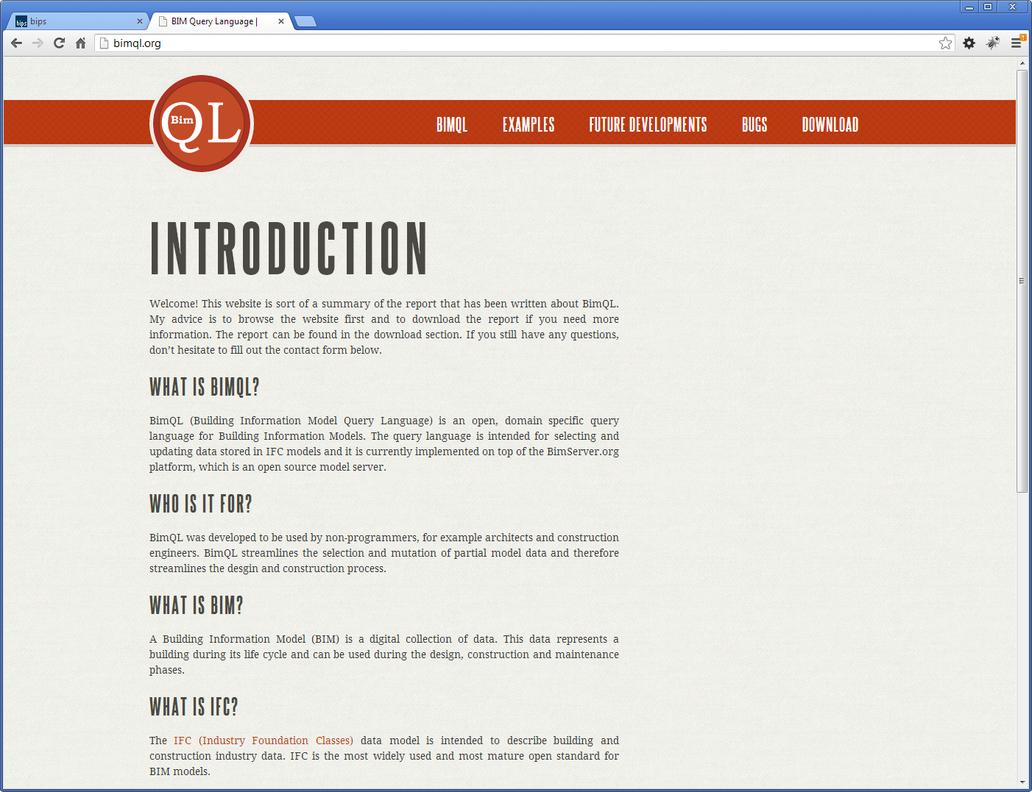

Where people are using it for…..

Slide 12
In short BIMserver is an IFC database
Data that comes in, is stored as objects in the database
We don’t have to translate IFC to our internal model (which makes it possible to build such a reliable import/export)
But we also DO NOT analyze geometry
Geometry in IFC are objects; we store the objects as is
Downside:
When you want to transform to others formats someone has to do CSG / Boolean operations*
(and as a server we don’t feel it is up to us)
* = For example for our IFC->GIS experiment in 2009

Slide 13

IfcOpenShell.org

Slide 14
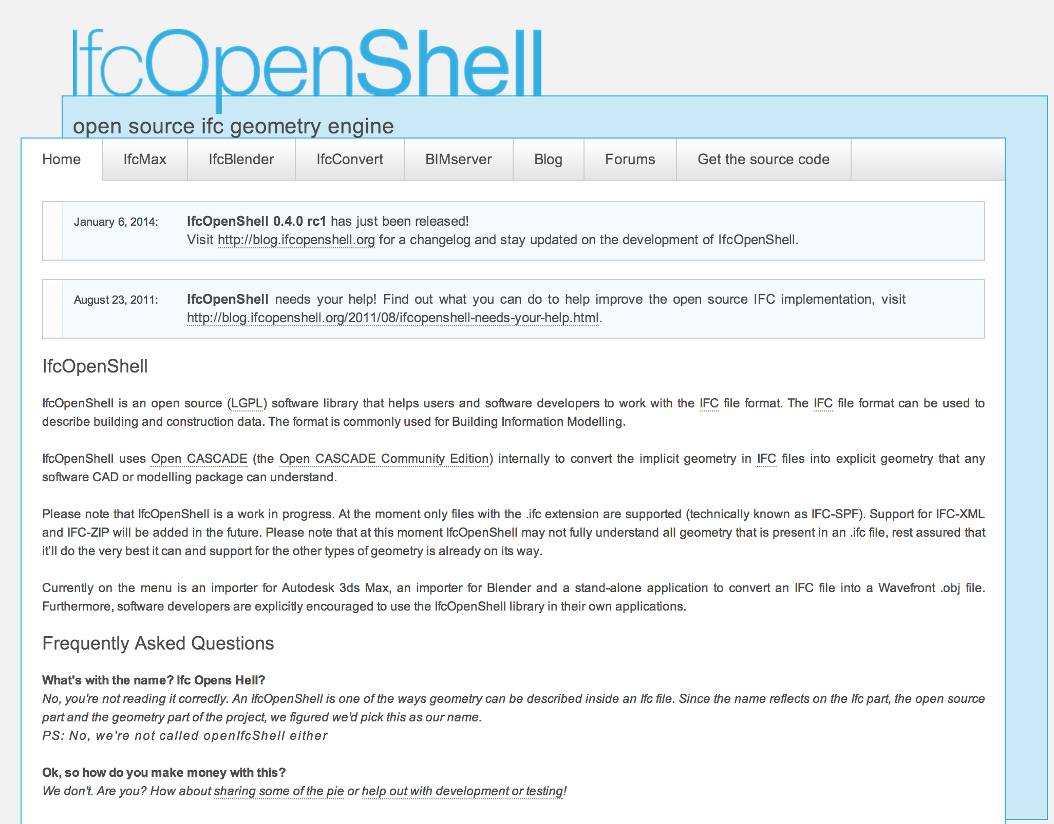

Slide 15
Thanks to the collaboration
IFC geometry is now rendered during check-in (optional)
Geometry is stored in BIMserver database to make is accessible for all other plugins (serializers, services, etc) and developers
Much better color support then most commercial tools
Geometry optimization (efficiency)
Pretty reliable

Slide 16

And then…

Slide 17
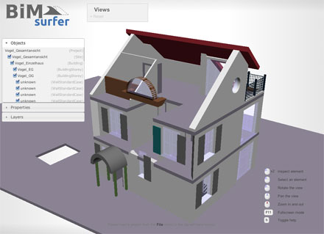
BIM Surfer www.bimsurfer.org SceneJS based WebGL application to view IFC in a webbrowser

Slide 18
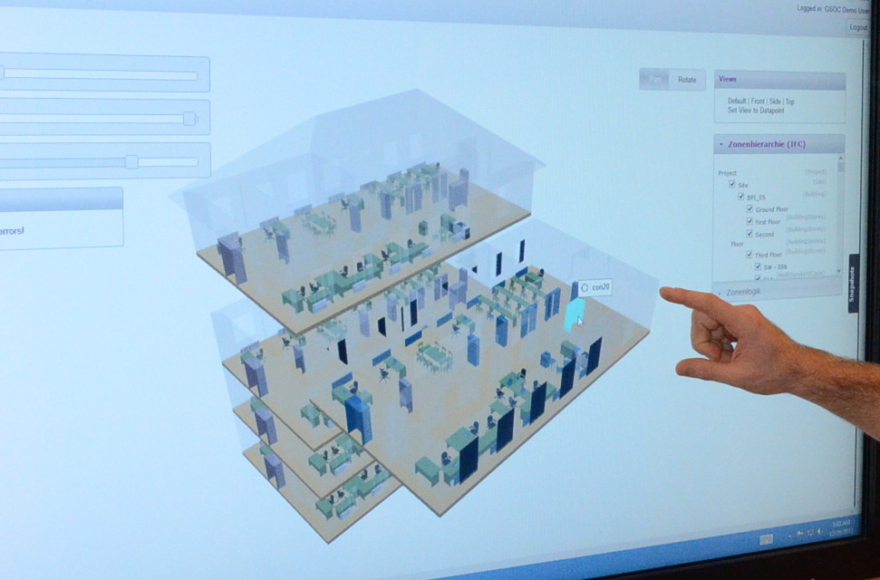
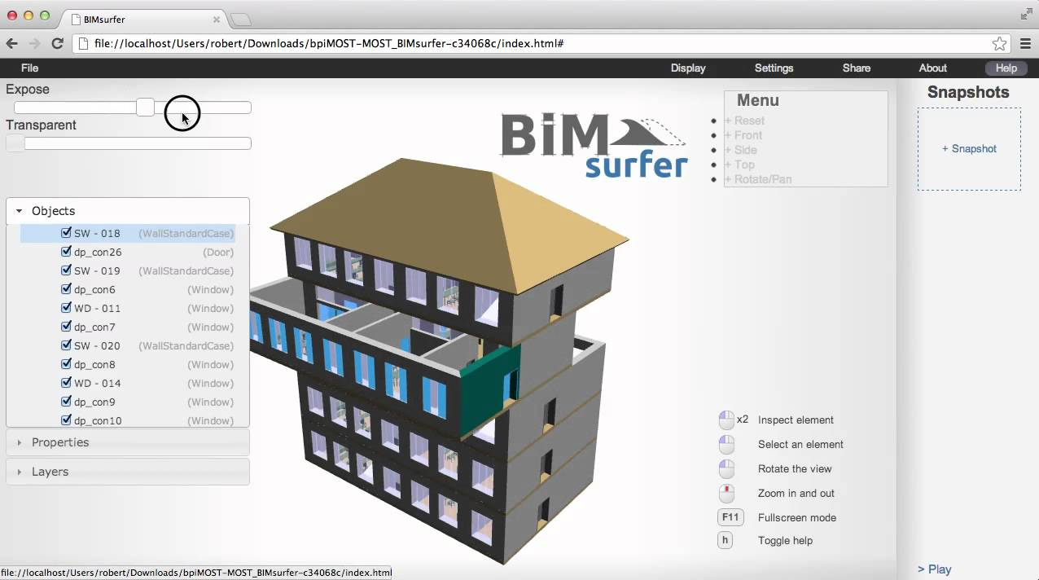
Vienna fans made ‘expose’ and ‘transparent’ sliders

Slide 19
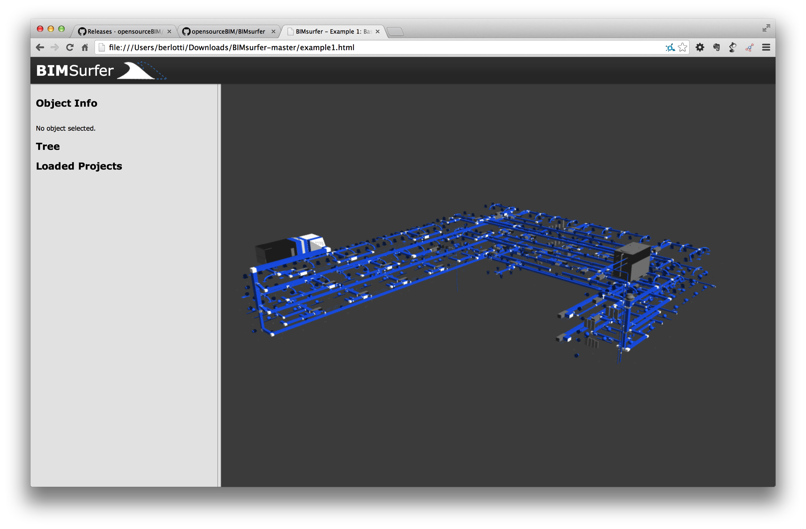
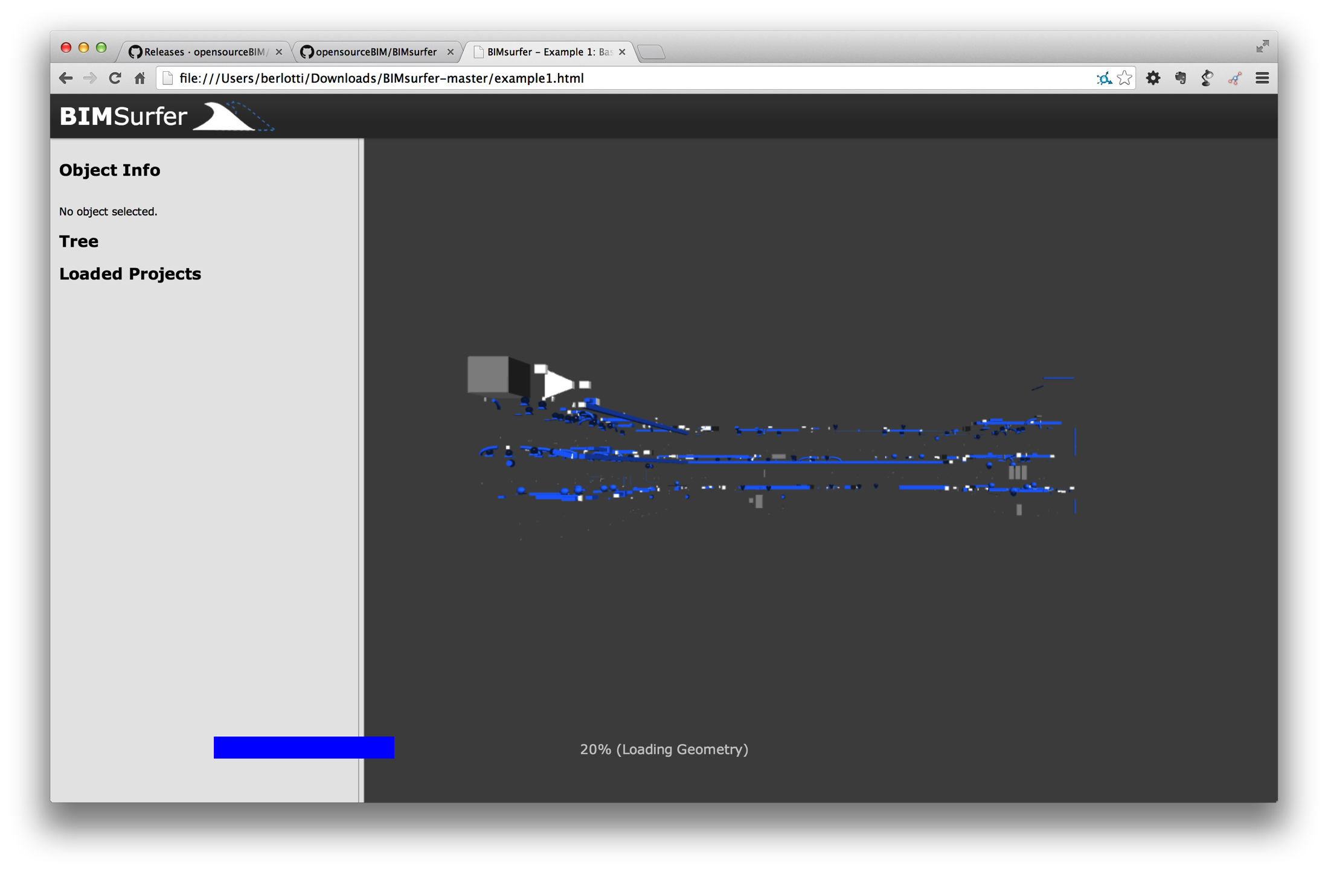
“Complete” rewrite in 2014
From spaghetti code to modular code with API (and events)
Example1.html

Slide 20

We made it official

Slide 21
And others joined….
bimvie.ws (html/javascript GUI; also available as BIMserver plugin)
BimQL (open BIM query language)
COBie plugins (to support COBie in BIMserver)
Most recent (unstable):
BCF server (wordpress plugin to create a BCF topic server)
BCF Forum (combines BCF Server, BIMserver and BIM Surfer to create a dashboard to discuss issues of your BIM)

Slide 22






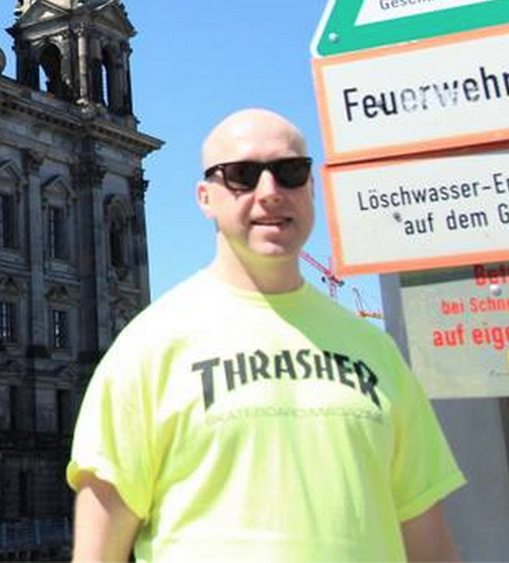








Slide 23
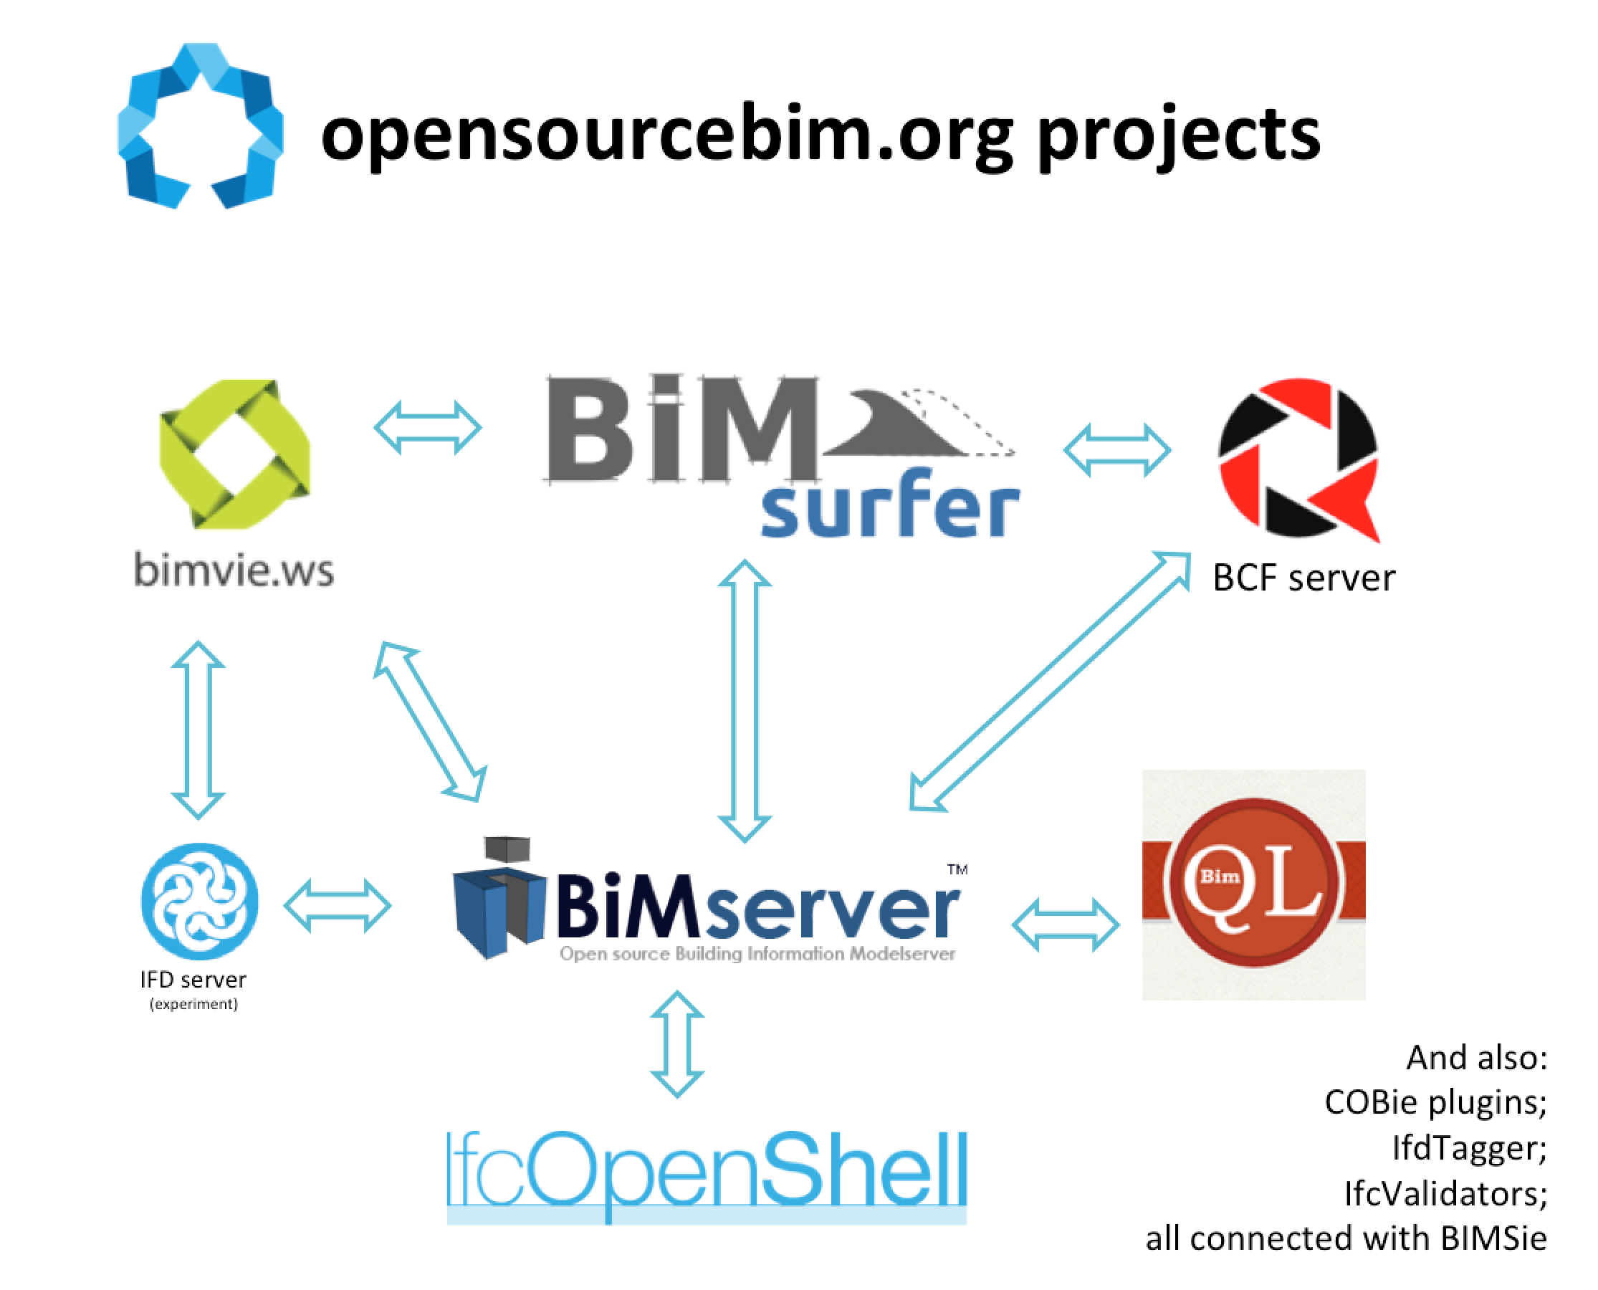
Part of a bigger picture

Slide 24
Some promising newcomers:
BcfReporter
ConceptLibraryLink (for BIMserver)
openIFD (experiment to build bottom-up concept libraries)
And honorable mentions of silently died projects:
Java3D viewer
BOM extractor
IfcObjectTagger
WebGL-ThreeJS

Slide 25
Interconnecting
During the interconnection of the different tools we found that we needed to standardize and document interfaces between the separate projects:
BIMSie between (more generic) BIM services
Between IFC render engines and BIMserver
Between BIMserver and BIM Surfer (streaming, binary)
BCF server interface (beta)
Documenting them (well… at least plan to) on openbimstandards.org
But don’t take this too serious… We are BuildingSMART fans!

Slide 26
Best place to go: https://github.com/opensourceBIM/ Special for the AEC Hackathon 1.1: https://github.com/opensourceBIM/AECHackathon/wiki

